Slide 1

Group 1-Cambodia
Big Data for Developing Action Plan for Concerned SDGs in Cambodia
Phnom Penh, February 3rd, 2022

Slide 2
Contents
Introduction (Description)
Timeframe (When)
Related Stakeholders (Who)
Methodology/Strategies/Plan (What to do)
Supported Data (Big data)

Slide 3
1.
Introduction

Slide 4

Cambodia SDGs (2016-2030)
គោលដៅអភិវឌ្ឍន៍ប្រកបដោយចីរភាពកម្ពុជា

Slide 5
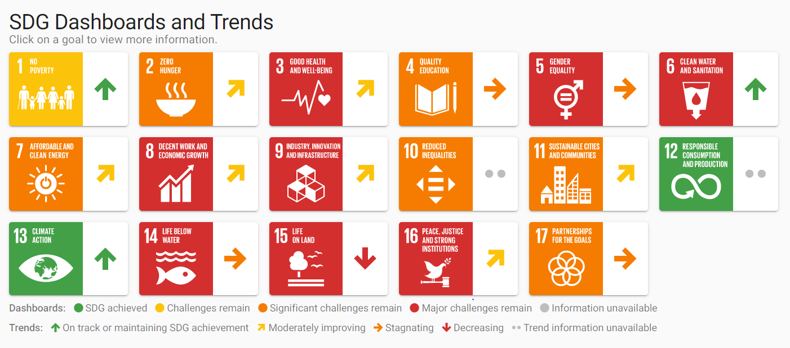
Goal #3: Good Health and Well-being

Slide 6
The localization of SDG 3 in Cambodia
At the end of 2018, the Royal Government of Cambodia approved the Cambodian Sustainable Development Goals (CSDGs) Framework 2016–2030.
Of all the goals, CSDG 3 is one where the highest proportion of SDG targets and indicators have been picked up. The global framework has 13 targets and 27 indicators, while the framework for CSDG 3 has 11 targets and 21 indicators.

Slide 7
3.1 By 2030, reduce the global maternal mortality ratio to less than 70 per 100,000 live births.
3.2 By 2030, end preventable deaths of newborns and children under 5 years of age, with all countries aiming to reduce neonatal mortality to at least as low as 12 per 1,000 live births and under-5 mortality to at least as low as 25 per 1,000 live births.
3.3 By 2030, end the epidemics of AIDS, tuberculosis, malaria and neglected tropical diseases and combat hepatitis, water-borne diseases and other communicable diseases (per 1000).
3.4 By 2030, reduce by one third premature mortality from non-communicable diseases through prevention and treatment and promote mental health and well-being (​ per 1000).
3.5 Strengthen the prevention and treatment of substance abuse, including narcotic drug abuse and harmful use of alcohol.
3.6 By 2030, have the number of global deaths and injuries from road traffic accidents.
3.7 By 2030, ensure universal access to sexual and reproductive health-care services, including for family planning, information and education, and the integration of reproductive health into national strategies and programmed.
3.8 Achieve universal health coverage, including financial risk protection, access to quality essential health-care services and access to safe, effective, quality and affordable essential medicines and vaccines for all.
3.9 By 2030, substantially reduce the number of deaths and illnesses from hazardous chemicals and air, water and soil pollution and contamination.
3.A Strengthen the implementation of the World Health Organization Framework Convention on Tobacco Control in all countries, as appropriate.
3.C Substantially increase health financing and the recruitment, development, training and retention of the health workforce in developing countries, especially in least developed countries and small island developing States.

Slide 8
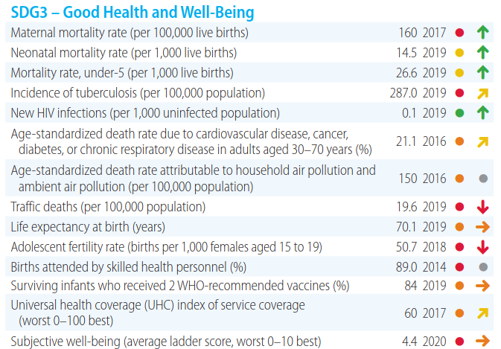
Current Status of Cambodia SDG 3

Slide 9
2.
Timeframe

Slide 10
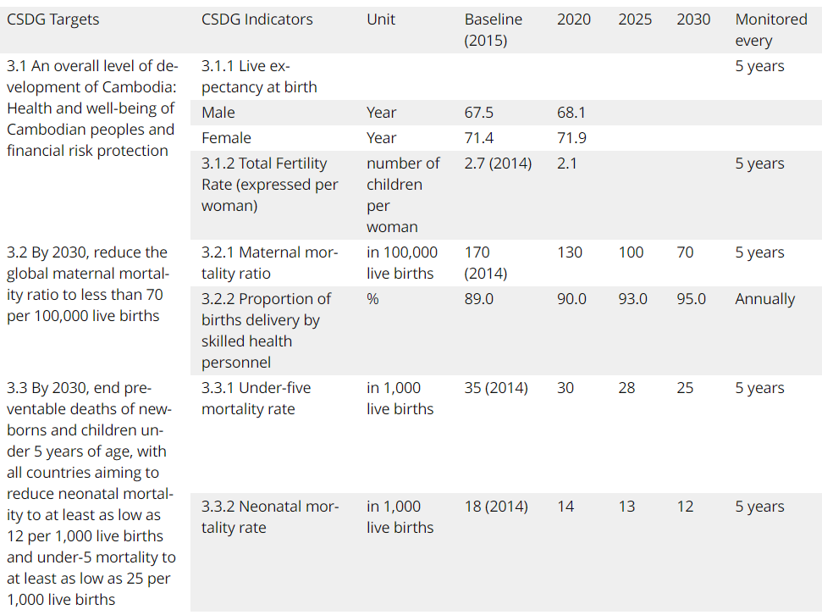
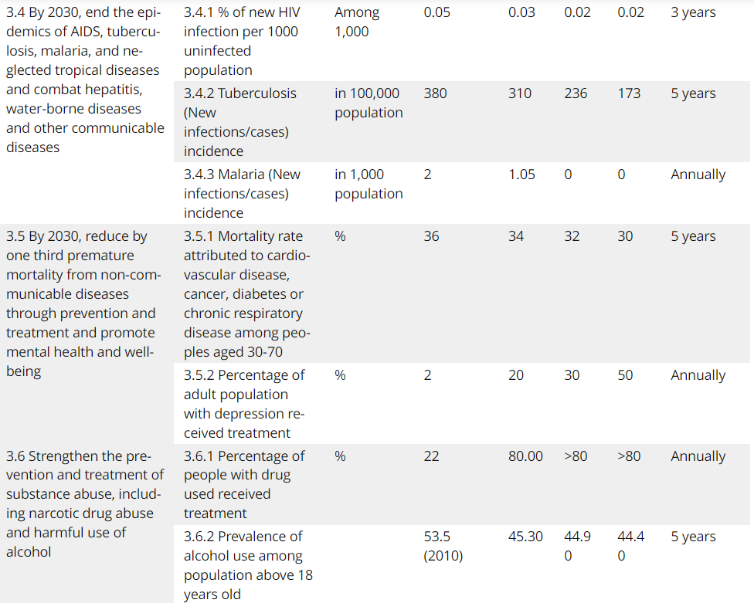
Timeframe for each target and indicators

Slide 11
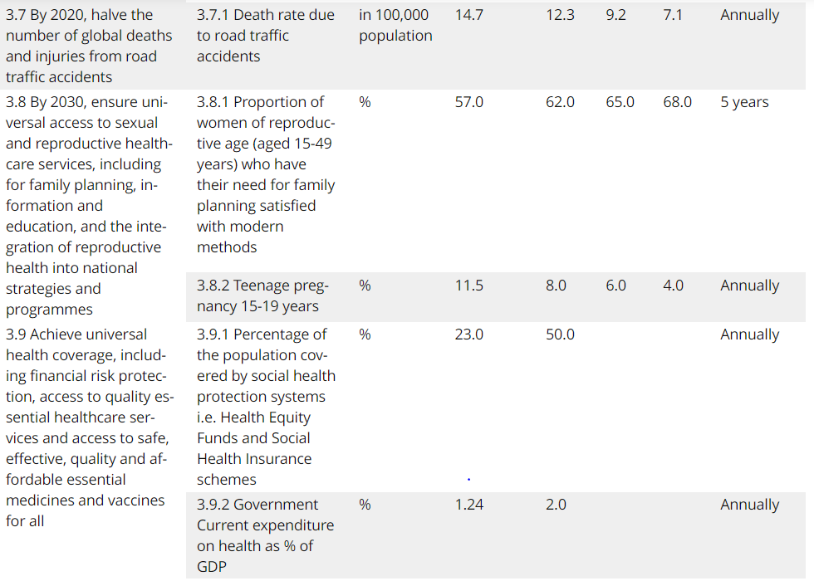
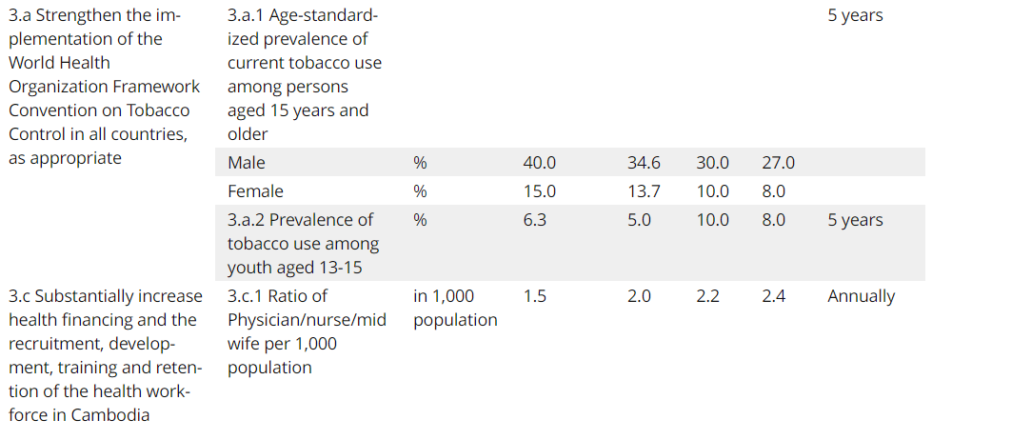
Timeframe for each target and indicators

Slide 12
3.
Task Team Members (Who)

Slide 13






Stakeholders/ Task Team Members
Hospitals and Healthcare System
Pharma companies
Insurance providers
Medical labs, federal and state government department and agencies
Heath information techology vendors
Healthcare consulting companies, physician offices and group

Slide 14
4.
Methodology Strategies/Plan

Slide 15
SWOT Analysis
STRENGTHS
Political will
Improving the governing
Staff commitment
Technology
WEAKNESSES
Lack of a proper government structure to guide department of HIS
Still lack of interdepartmental collaboration
Human resource
ICT capacity
Lack of data quality and data analysis
S
W
Political commitment to SDG 3
Economic growth
ICT expansion
Internet connectivity
Availability of web and cloud based platforms
OPPORTUNITIES
Unstable funding and budget
Slow progress by related ministries
Comminity involvement
Software development and maintenance
Data security and standards
THREATS
O
T

Slide 16
Action Plan
Strategic Priority 1: Leadership and Governance
International experience has demonstrated that the successful implementation of integrated Health Information Systems (HIS) is complex and that it requires a strong national Strategic Action Plan.
Strategic Priority 2: Legislation, Policy & Compliance
HIS affects multiple stakeholder types and extends across multiple domains, including personal health, healthcare provision, ICT and management.
Strategic Priority 3: Stakeholder Engagement
HIS requires effective collaboration in order to succeed.
Strategic Priority 4: Services, Applications and Tools
There is a wide range of digital applications and tools with the potential to support and improve healthcare delivery.
Strategic Priority 5: Standards and Interoperability
Standards are the cornerstone of the HIS Action Plan implementation.

Slide 17
Action Plan
Strategic Priority 6: Capacity and Workforce
Having adequate human resource capacity is essential to successful delivery on this Action Plan.
Strategic Priority 7: Investment, Affordability and Sustainability
Before commencement of the Action Plan implementation, financing must be procured and its sustainability assured over the total duration of the Plan.
Strategic Priority 8: Infrastructure
The incremental approach adopted by this Action Plan aims to deploy eHealth capability in a step-wise manner
Strategic Priority 9: Benefits Realization
Specific actions are required to ensure that Action Plan interventions deliver on their promise and that anticipated benefits are realized for all stakeholders. These actions, which include all change management interventions including transitioning from NGO partners in regard to HMIS and PMRS by end of 2018, need to be clearly identified and planned.
Strategic Priority 10: Monitoring and Evaluation of the Action Plan
It is essential to monitor and evaluate performance on the implementation of the Action Plan on an ongoing basis. This will ensure that the objectives are being adhered to; lessons learnt are captured and used as inputs for future planning.

Slide 18
5.
Supported Big Data

Slide 19
Big data for action plan
3.2 By 2030, end preventable deaths of newborns and children under 5 years of age, with all countries aiming to reduce neonatal mortality to at least as low as 12 per 1,000 live births and under-5 mortality to at least as low as 25 per 1,000 live births.

Slide 20
Big data for action plan
3.3 By 2030, end the epidemics of AIDS, tuberculosis, malaria and neglected tropical diseases and combat hepatitis, water-borne diseases and other communicable diseases (per 1000).

Slide 21
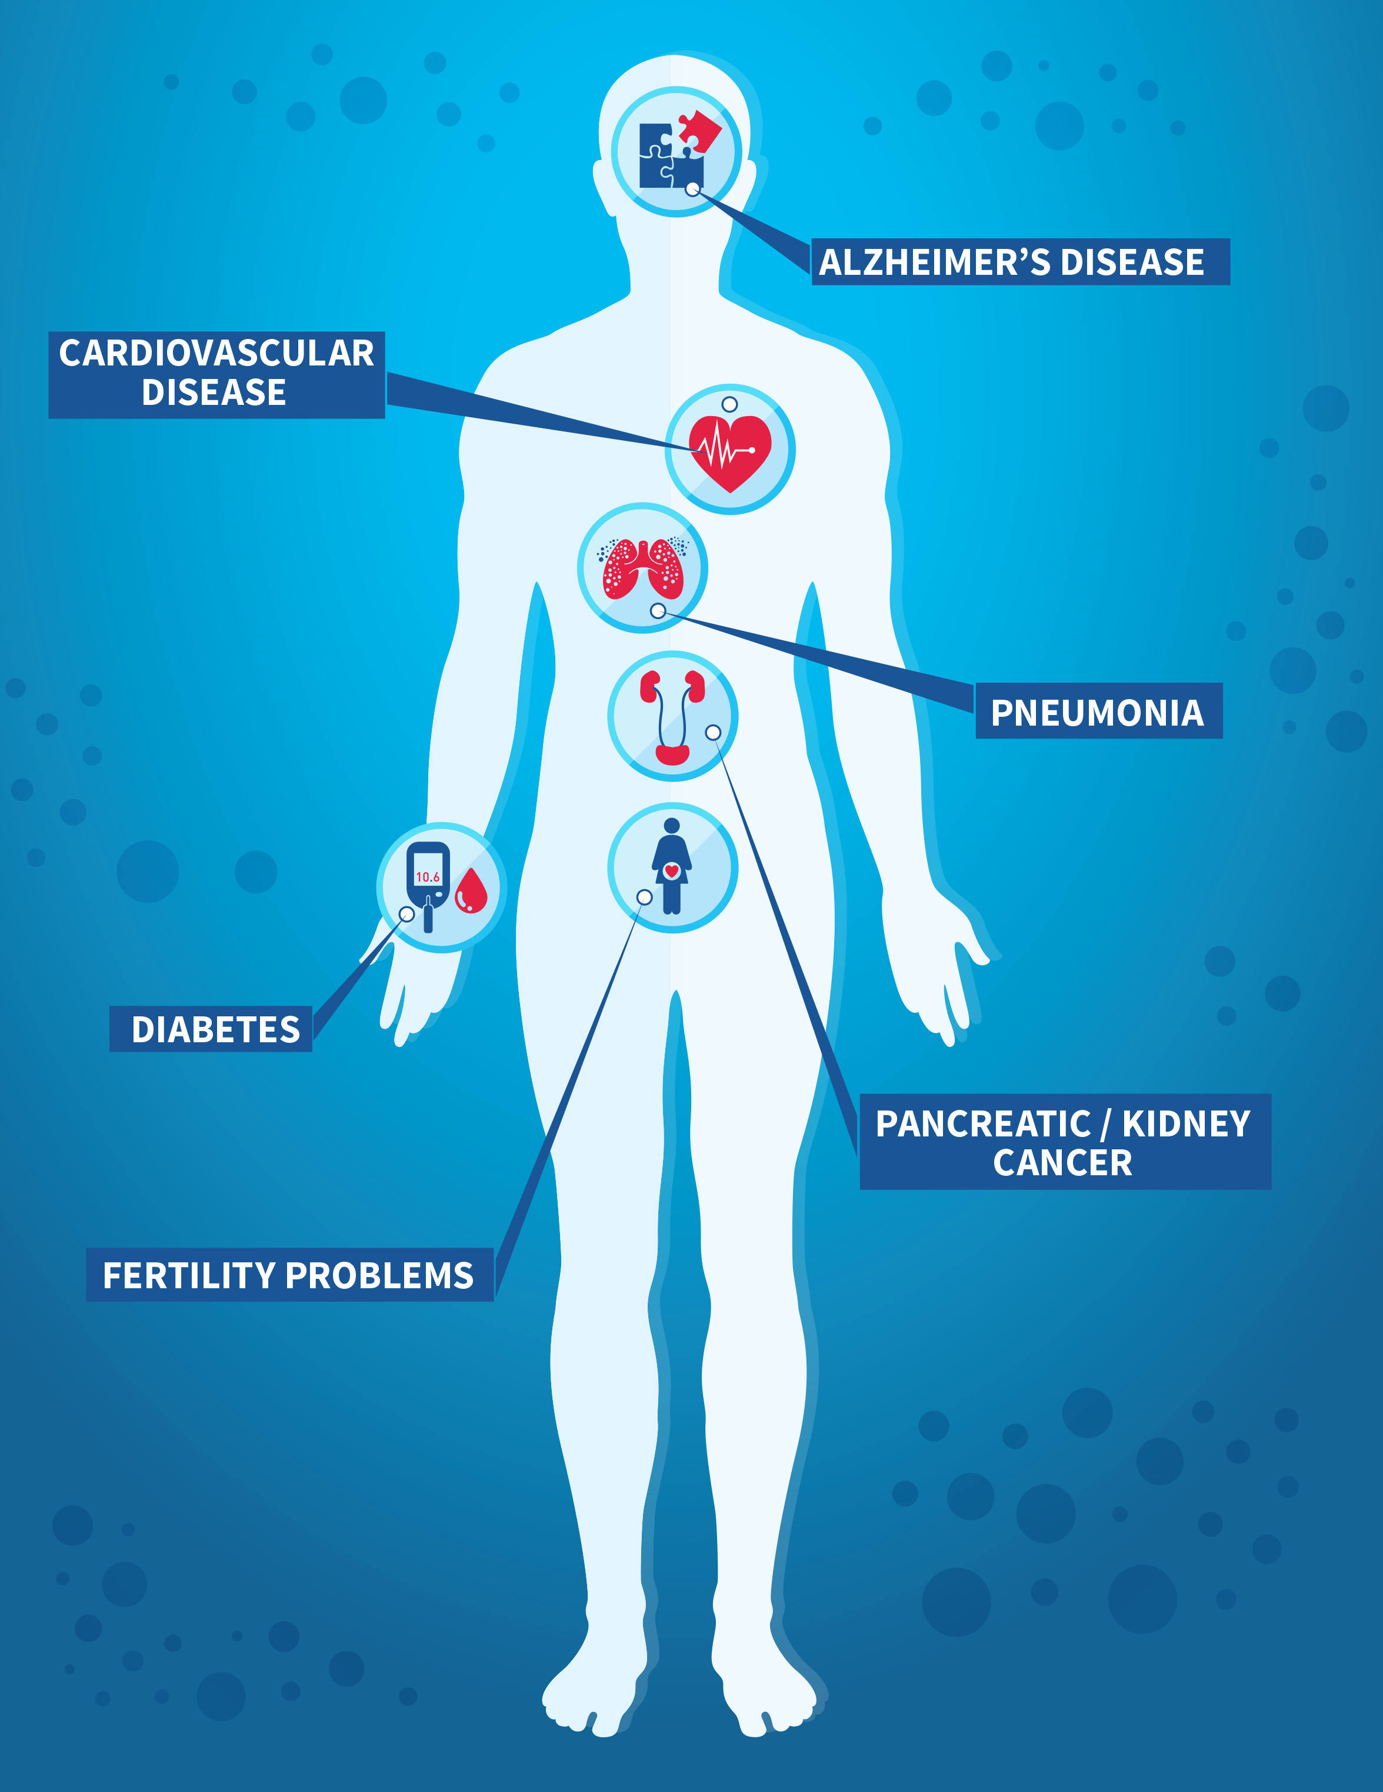
Big data for action plan
3.4 By 2030, reduce by one third premature mortality from non-communicable diseases through prevention and treatment and promote mental health and well-being (​ per 1000).
Type of Data
Unstructured data:
Medical image (x-ray, MRI, CT …)
signal (heart sound, brain wave…)
Structured Data:
patient record: (Age, gender, type of disease, duration of affected by disease)
Ministry of Health
University of health and science
Big data available online? NO!
Data collection
National hospital and medical lab

Slide 22
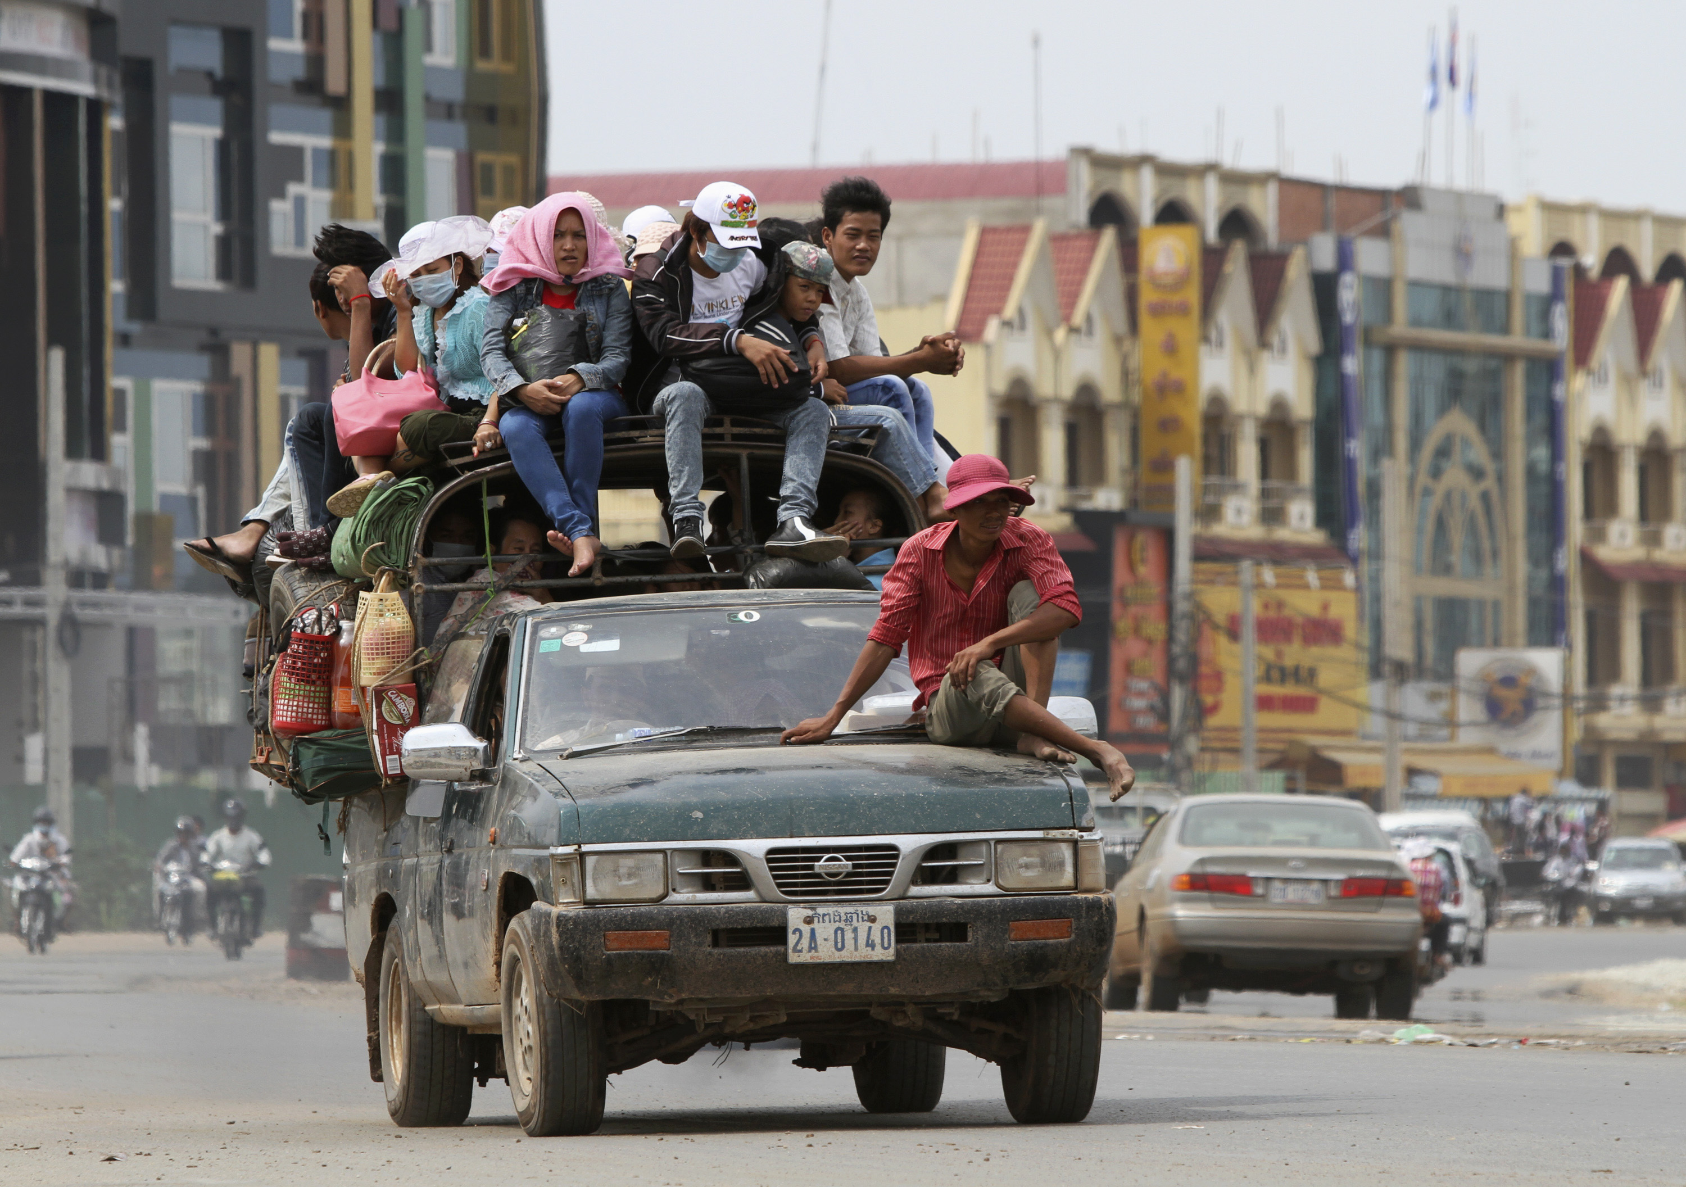

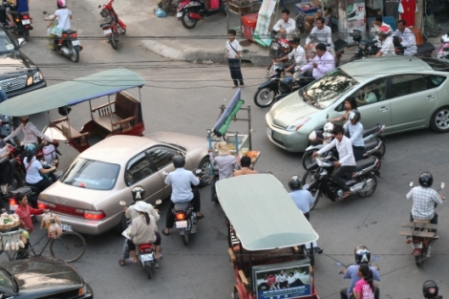
Big data for action plan
3.6 By 2030, have the number of global deaths and injuries from road traffic accidents.
Type of Data
Unstructured data:
CCTV (video and image) for analysing traffic
social media (video, voice and text)
Structured Data: (forecasting )
data contained four attributes, namely accident number, accident type, accident location and accident time.
Geographic Location is Converted to Latitude and Longitude
Ministry of Interior
Big data available online? NO!
Data collection and scrapping

Slide 23
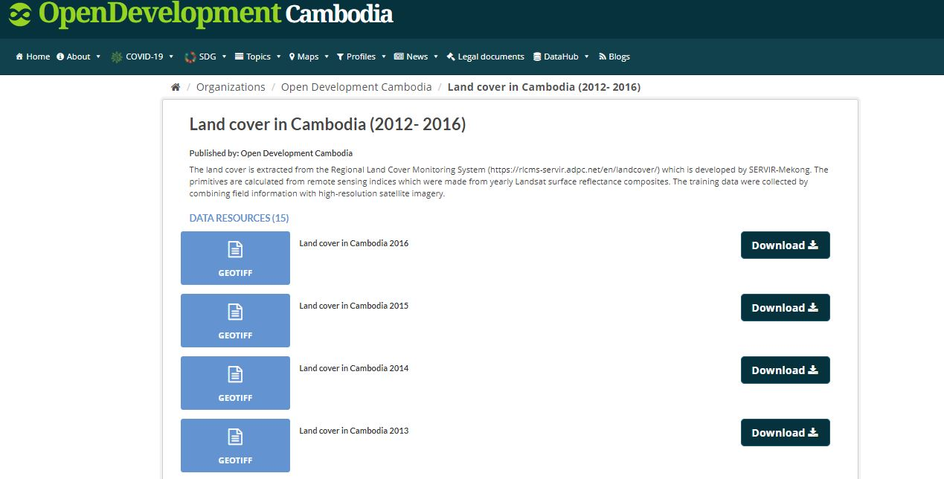


Remote Sensing Big data for action plan
Remote sensing data:
- Open Development Cambodia
- Landsat (USA)
- Sentinel ESA

Slide 24
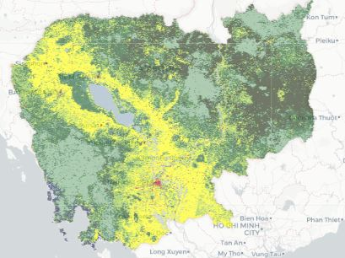
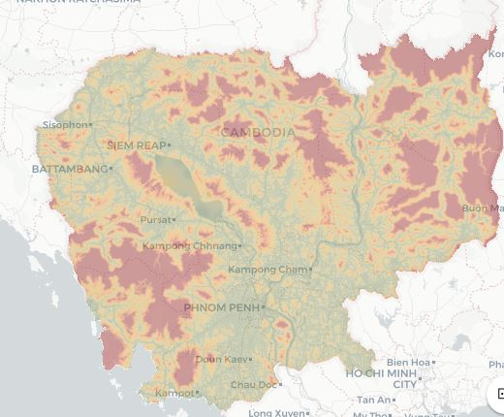
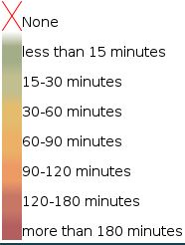
Remote Sensing Big data for action plan
HOW?
Satellite images and AI to measure the rural area community population
Used satellite image and machine learning to classify urban and rural area
Satellite images application for identify rural area community to access to health center
Using satellite image for detection air quality

Slide 25
Resource of Big Data
Healthcare data from hospitals
Ministry of Health of Cambodia
Medical labs such as Pasteur institute of Cambodia
WHO
Related ministries
Private sectors

Slide 26
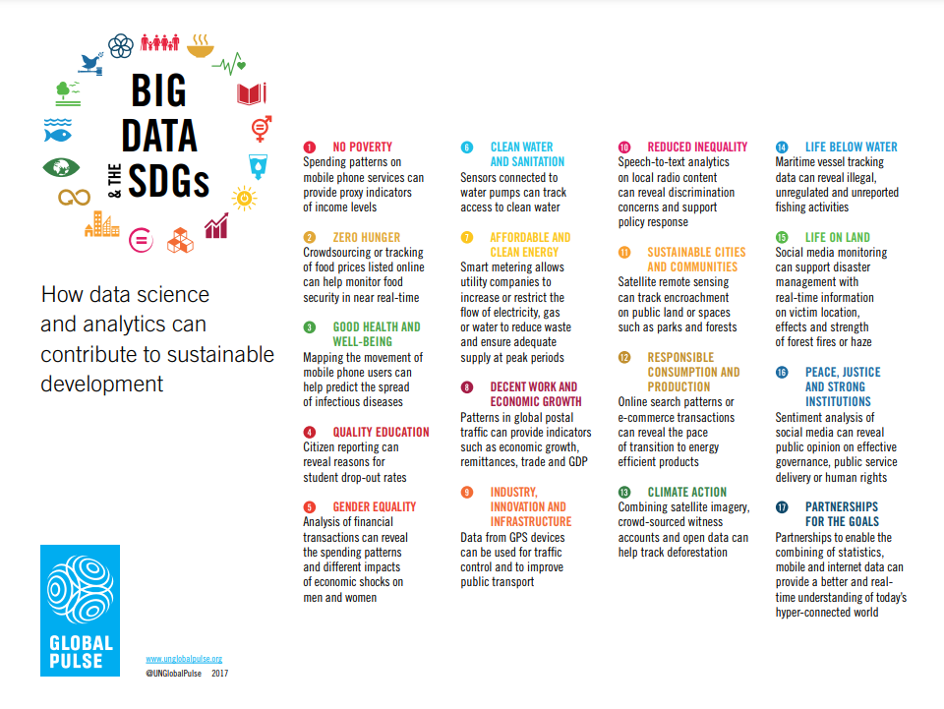

Slide 27
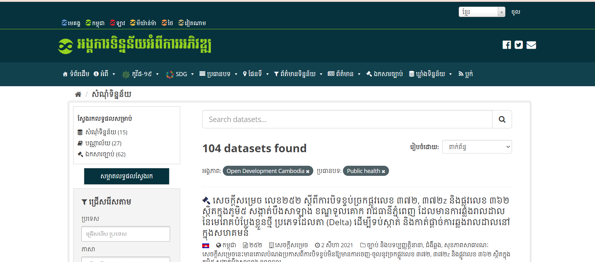
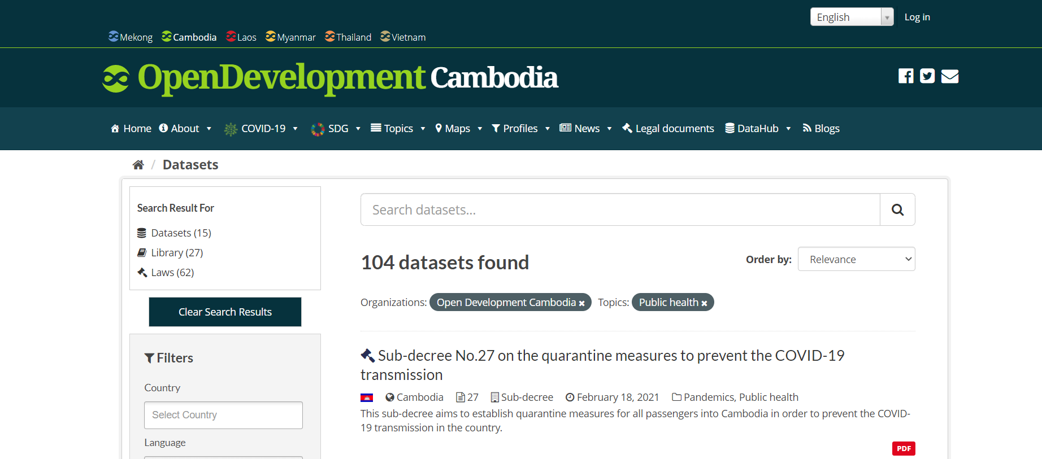
Open Data Source

Slide 28
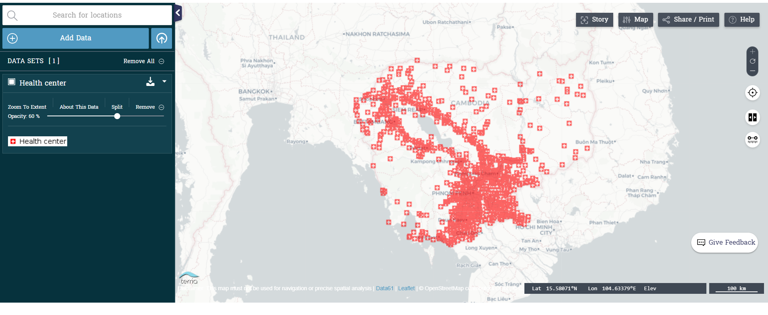
Number of Health Care Centers
https://data.opendevelopmentcambodia.net/dataset/health-facility-of-cambodia-2010/resource/f2ca35cd-340f-4dc5-a9e7-5c8fa72b6a21/view/c4325365-df35-468d-9df3-0dd46d960891

Slide 29
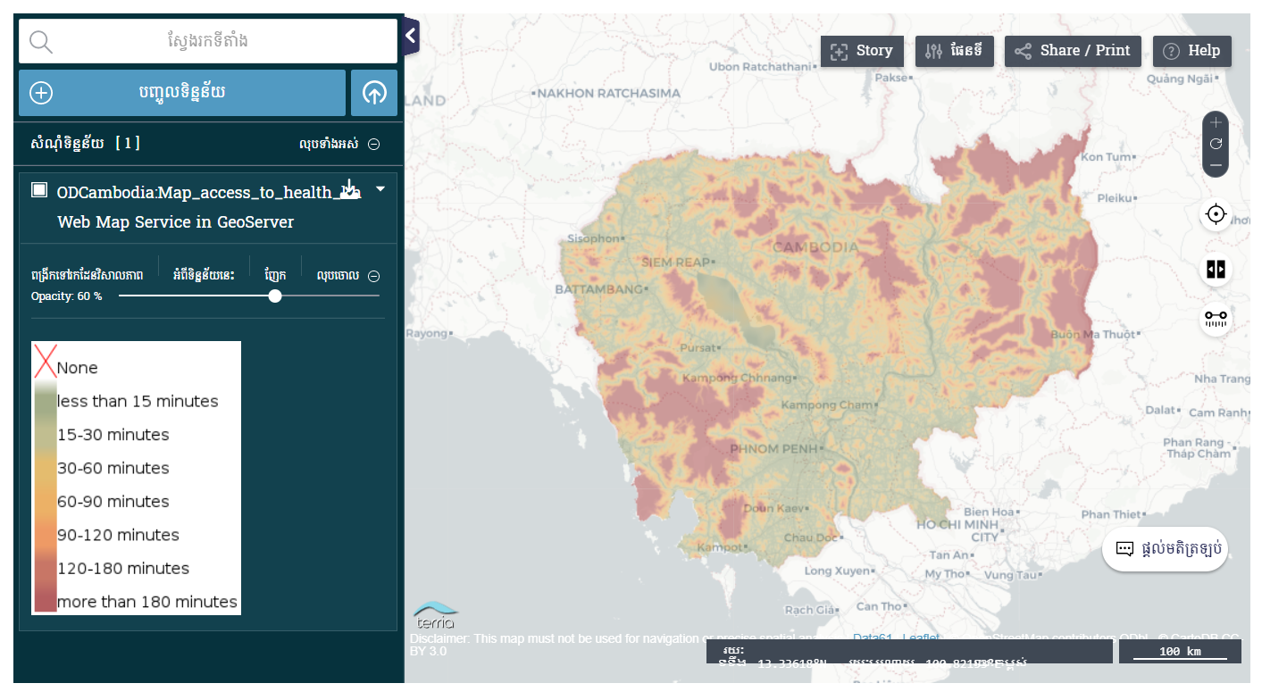
Distance from home to health care center (សំណុំទិន្នន័យនេះ ផ្តល់នូវព័ត៌មានទាក់ទងនឹង លទ្ធភាពដែលអាចទៅកាន់មណ្ឌលសុខភាព នៅទូទាំងប្រទេសកម្ពុជា ដោយដកស្រង់ចេញពី អង្គការសុខភាពពិភពលោក (WHO)។ អង្គការទិន្នន័យអំពីការអភិវឌ្ឍ...)

Slide 30
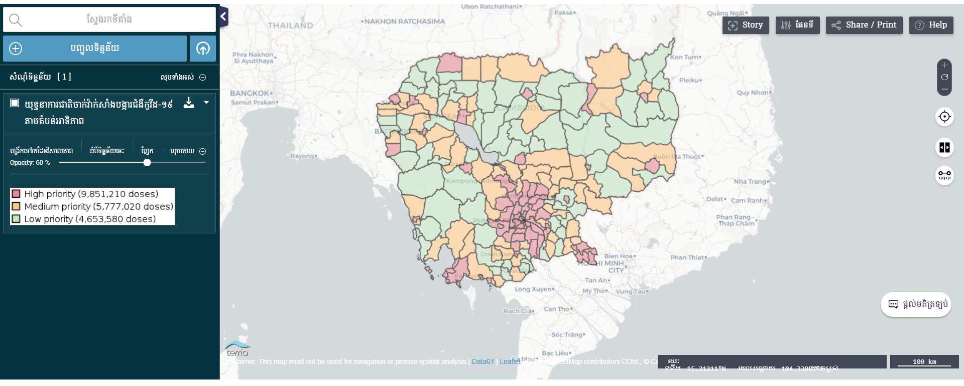
អំពីវិទ្យាស្ថានបច្ចេកវិទ្យាកម្ពុជា
Covid-19 Vaccination Action Plan

Slide 31
Budget Plan

Slide 32
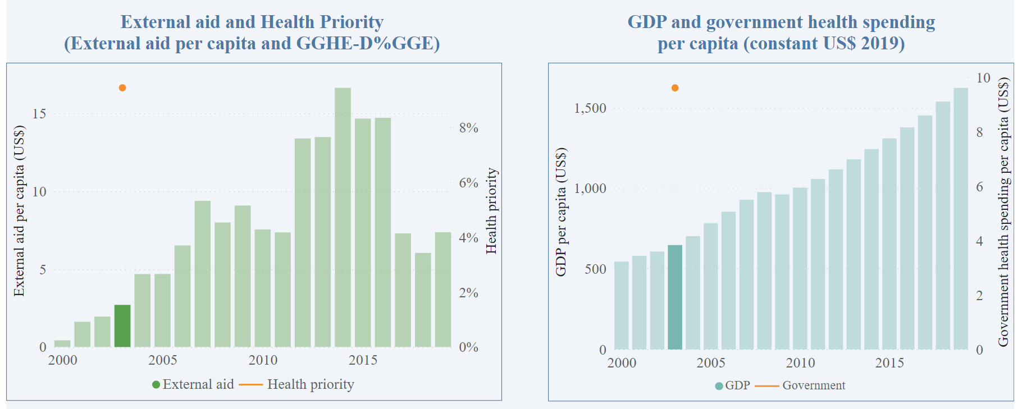
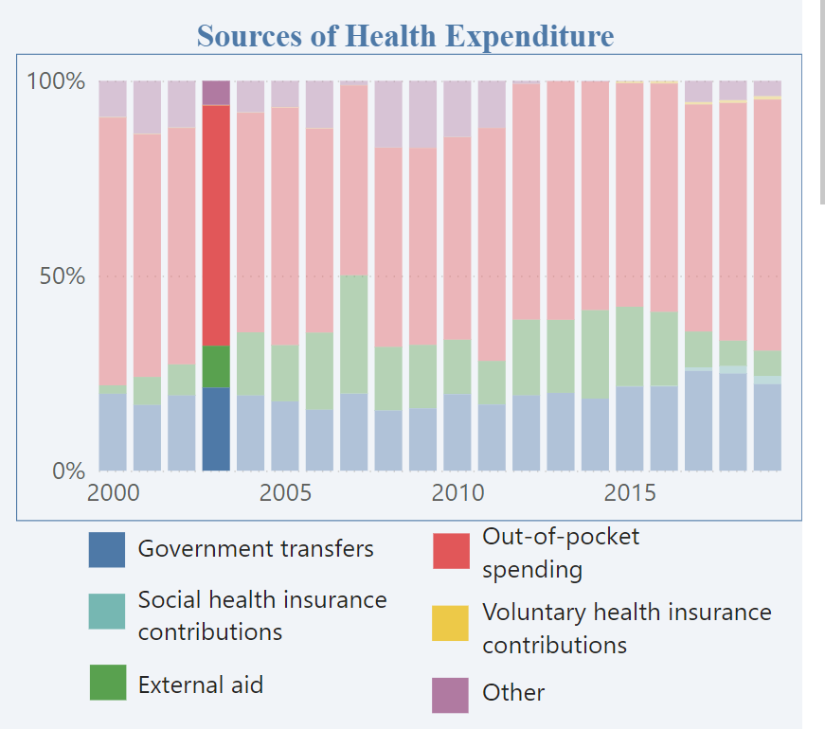
Expenditure Profile (https://apps.who.int/nha/database/country_profile/Index/en)

Slide 33

Thank You!
.

Slide 34
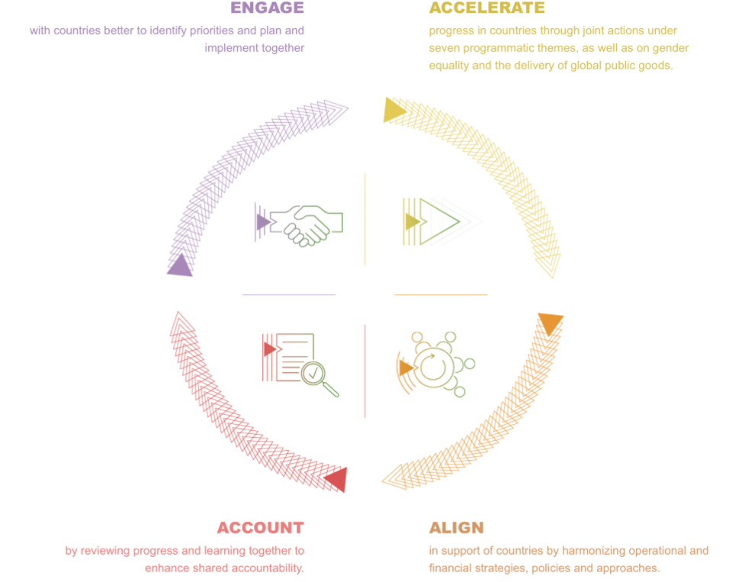
Engage, Accelerate, Align, Account

Slide 35
1.
SDG 3: Methodology/Strategies

Slide 36
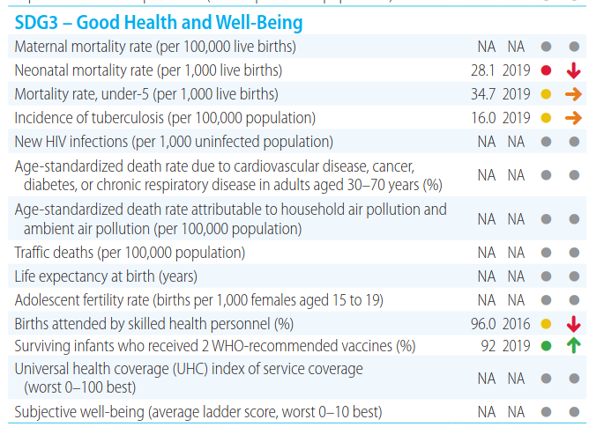

Slide 37
National strategic priorities of Cambodia: The overarching policy goal of The Third Health Strategic Plan 2016–2020 (HSP3) of the Ministry of Health is “improved health outcomes of the population, with increased financial risk protection in access to quality health care services”. HSP3 is supported by four Health Development Goals:
Goal 3
Goal 1
Reduce morbidity and mortality caused by communicable diseases.
Increase access to and utilization of affordable quality health services with reduced financial burden.
Goal 2
Reduce morbidity and mortality caused by noncommunicable diseases and other public health problems.
Reduce maternal, newborn and child mortality, as well as malnutrition among women and children.
Goal 4

Slide 38
Existing facing Problem ->Objectives ->Solution

Slide 39
Timeframe (have clear activities for each targets) Problem -> Objectives -> Action for solution
Target | Problem | Objectives | Actions/Solution

Slide 40
Timeframe
 | Implementation of Yearly (Monitor in every 5 years)
 | 2017 | 2018 | 2019 | 2020 | 2021 | 2022 | 2023 | 2024 | 2025 | 2026 | 2027 | 2028 | 2029 | 2030
Target 3.1 |  |  |  | 130 |  |  |  |  | 100 |  |  |  |  | 70
Target 3.2 |  |  |  | 14 |  | ◆ |  |  | 13 |  |  |  |  | 12
Target 3.3 |  |  |  | 310 |  |  |  |  | 236 |  |  |  |  | 173
Target 3.4 |  |  |  | 34 |  |  |  |  | 32 |  | ◆ |  |  | 30
Target 3.5 |  |  |  |  |  |  |  |  | ◆
Target 3.6
Target 3.7
Target 3.8
Target 3.9
Target 3.A
Target 3.C

Slide 41
Action Plan
Strategic Priority 1: Leadership and Governance
International experience has demonstrated that the successful implementation of integrated Health Information Systems (HIS) is complex and that it requires a strong national Strategic Action Plan. This Action Plan, set in the context of the DPHI’s strategic aims and aligned to the strategic priorities set by the MOH in the form of HSP3, recognises that leadership (political, executive and technical) is critical for the successful realisation of the Action Plan.
Strategic Priority 2: Legislation, Policy & Compliance
HIS affects multiple stakeholder types and extends across multiple domains, including personal health, healthcare provision, ICT and management. Efficient and effective implementation of the Action Plan require appropriate legislations, regulations and policies to be put in place with a high degree of compliance . While the potential benefits of HIS implementations are high, their realisation can be risky, costly and challenging.
Strategic Priority 3: Stakeholder Engagement
HIS requires effective collaboration in order to succeed. This can only be achieved by engaging with all stakeholder groups affected by HIS. This helps to mobilise support, identify opportunities, highlight priorities, manage and mitigate risk.
Strategic Priority 4: Services, Applications and Tools
There is a wide range of digital applications and tools with the potential to support and improve healthcare delivery. The applications include electronic medical record systems, healthcare information systems, surveillance systems, business intelligence for health, electronic content management, decision support and knowledge management. Tools include software and hardware devices, especially those used in eHealth and mHealth.
Strategic Priority 5: Standards and Interoperability
Standards are the cornerstone of the HIS Action Plan implementation. Besides interoperability standards which are essential for the accurate exchange of data, there is a requirement for national standards for procurement (hardware and software), software accreditation, data structure, terminology, clinical coding, security, messaging and the electronic health record.
Strategic Priority 6: Capacity and Workforce
Having adequate human resource capacity is essential to successful delivery on this Action Plan. This involves developing career paths, training and skill retention strategies in order to build up a workforce that can innovate, develop, deploy, maintain and support all eHealth interventions, especially health information systems and health management information systems. Define a standardised eHealth competency framework for health workers and health IT practitioners providing an understanding of required eHealth knowledge, skills and attributes for each professional group.
Strategic Priority 7: Investment, Affordability and Sustainability
Before commencement of the Action Plan implementation, financing must be procured and its sustainability assured over the total duration of the Plan. This requires proper planning and identification of benefits, so that value for money and affordability are balanced and results delivered as quickly as practically feasible. There is a need to undertake economic assessments of potentially beneficial interventions to support policy makers and MOH departments and national health programmes to make informed decisions when allocating scarce resources.
Strategic Priority 8: Infrastructure
The incremental approach adopted by this Action Plan aims to deploy eHealth capability in a step-wise manner. There are four areas which will provide the foundations for all other future eHealth activities: infrastructure, connectivity, registration of patients, facilities and providers, and a basic national electronic medical record.
Strategic Priority 9: Benefits Realisation
Specific actions are required to ensure that Action Plan interventions deliver on their promise and that anticipated benefits are realised for all stakeholders. These actions, which include all change management interventions including transitioning from NGO partners in regard to HMIS and PMRS by end of 2018, need to be clearly identified and planned. If they are not addressed adequately net benefits may not be demonstrated within a realistic timeframe and funding envelope.
Strategic Priority 10: Monitoring and Evaluation of the Action Plan
It is essential to monitor and evaluate performance on the implementation of the Action Plan on an ongoing basis. This will ensure that the objectives are being adhered to; lessons learnt are captured and used as inputs for future planning.

Slide 42
In 2018 the WHO adopted a five-year strategic plan to achieve the SDGs, particularly SDG 3. To track the impact of the strategic plan, a result framework has been established and is continuously being refined. The final version will be presented in January 2020.
The plan’s three targets, known together as the “triple billion” target, are:
Extending universal health coverage to one billion more people;
Ensuring better protection from health emergencies for one billion more people; and
Promoting better health and well-being for one billion more people.
S
O
T

Slide 43
The WHO is also promoting these six main lines of action to as a guideline to align efforts:
Intersectoral action by multiple stakeholders;
Health systems strengthening for UHC;
Respect for equity and human rights;
Sustainable financing;
Scientific research and innovation; and
Monitoring and evaluation.
S
O
T

Slide 44
Plan
Action 1
Action 3
Action 5
1
3
5
2
4
6
Action 2
Action 4
Action 6

Slide 45
SDG 3 – “Ensure healthy lives and promote well-being for all at all ages” – has a monitoring framework made up of 13 targets and 26 indicators. It covers maternal (3.1) and newborn/children’s health (3.2), communicable (3.3) and non-communicable diseases (3.4), substance abuse (3.5), traffic accidents (3.6), reproductive health (3.7), and environmental health hazards (3.9). The means of implementation targets (3.A to 3.D) cover both financial (3.C) and non-financial (3.A, 3.B, and 3.D) means of implementation. Universal health care (UHC) (3.8) ties all these different aspects together. Along with SDGs 1, 2, 4, and 5, SDG 3 is people-focused and aims to establish conditions that protect human dignity and assist those who are farthest behind.

